Slide 1
Verification of the In-Situ Upgrading Model

Slide 2
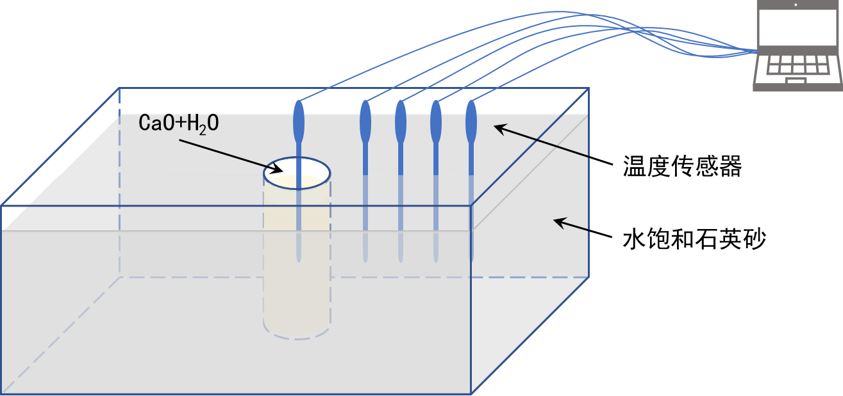
1. Verify the temperature evolution
Experiment
沉积物氧化钙增温实验示意图
Experimental Set-up
Sediments：quartz sand (grain size: 120-180 mesh )
porosity：38%
Saturation：100% (distilled water)
Model size：19.5×13×6 cm，mock wellbore: 2.5 cm
Reactant：20 g CaO + 20 g water
Monitoring：1 thermometer in wellbore，4 in sediments with the interval of 1.6 cm. Depth: 3 cm
Initial temp.：24.5℃

Slide 3
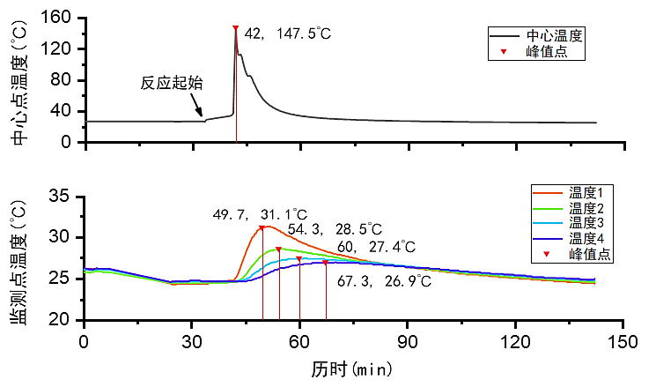
Experiment results
Temp.-Time curve of the injection point
Temp.-Time curve of the monitoring points

Slide 4
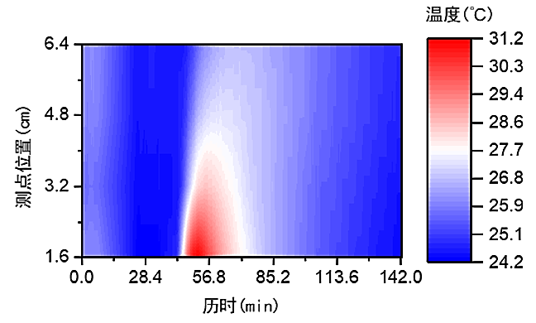
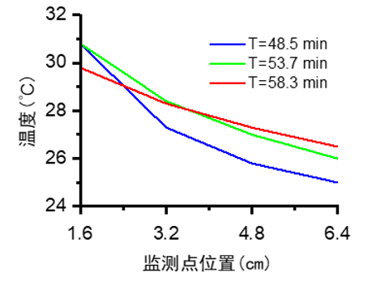
Experiment results
sensor
sediments
Mock well
Evolution of temperature field with time in every monitoring points
Temp. profile

Slide 5
Model Simulation
The model is built using the simulation of the heat injection with power injection as boundary condition. Therefore the injection is done controlling the energy released during the chemical reaction CaO + H2O (using trial and error).
The matching is done using the temperature of the first thermometer.
The experiment lacks the information like: Heat rock capacity, heat conductivity of the rock, rock density.
The experiment lacks control of the boundary effects like ambient temperature
19.5cm
13cm
y
Mesh grid= 2500 cells
x
z
19.5cm
6cm
13cm

Slide 6
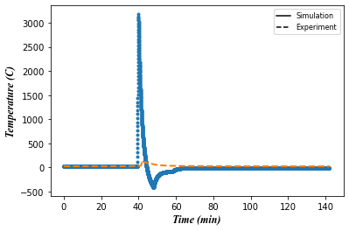
Case No. 1 Good trend in the monitoring points
Injection Point attribute | Rock attribute
Heat rate = 1000 watts | -
ca_mc =10 | -
fa_heatg = 2.0 | fa_heatg = 1.0
The initial simulations is focused in the control of the power injection until reach the trend of the first monitoring point, however it is realized the temperature injection reached high values, then the ca_mc attribute is increased until it does not have any change in the monitoring point
Injection Point

Slide 7
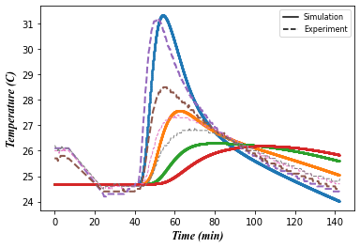
Case No. 1 Good trend in the monitoring point
Monitoring Points
The subsequent monitoring points follow the trend of the simulation but no totally accurate.
it is believed is due to the ambient temperature that possible also affects the system cooling.

Slide 8
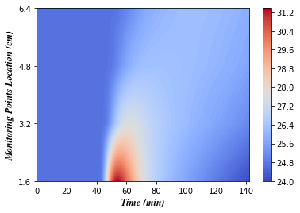
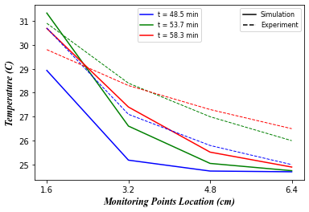
Result No. 1 Good trend in the monitoring point
Monitoring Points

Slide 9
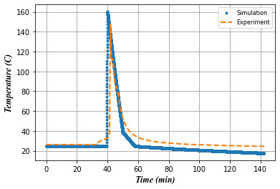
Case No. 2 Good trend in the injection point
Injection Point attribute | Rock attribute
Heat rate = 1000 watts | -
ca_mc =300 | ca_mc =vol*2600*1000n -1.3
fa_heatg = 2.0 | fa_heatg = 1.0
This value is reduced to reach the injection temperature and not reduce the monitoring points temperature
Injection Point

Slide 10
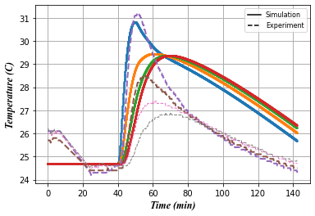
Result No. 2 Good trend in the injection point
Monitoring Points
Good agreement in the max temperature of the first monitoring point
But it is difficult to control the others monitoring points
This differences are due to the cooling effects due to the ambient temperature (Boundary effects)
This effects are difficult to control due the experiment is done in a open system

Slide 11
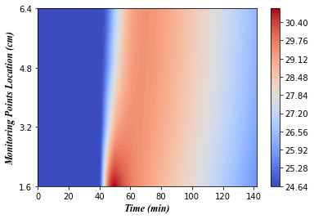
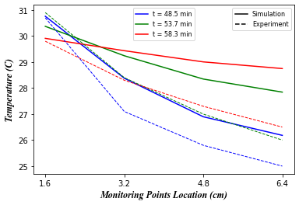
Result No. 2 Good trend in the injection point
Monitoring Points
Boundaries effects
Temp. ambient effects

Slide 12
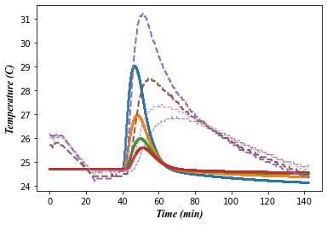
Case No. 3 Considered Boundaries
It was taken cells of the current 2D model with constant temperature in order to simulate the efect of the cooling effect of the ambient in the rock on the experiment.
The model is 2D therefore the perimeter cells were taken. However, the simulation shows that if all the perimeters are taken the temperature of the rock decrease highly, therefore the perimeters in y axis were only taken since it got better trend as show win the figure
Boundary attributes
Temp = 24.7 C
fa_heatg = 1.0
2 cm of perimeter cells
13cm
19.5cm

Slide 13
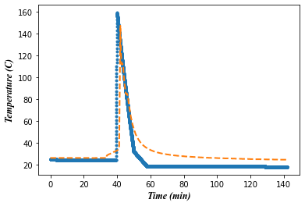
Boundary conditions, 2D Model.
Injection Point attribute | Rock attribute | Boundary Attribute
Heat rate = 1000 watts | - | ca_t = 24.7 C
ca_mc =300 | ca_mc =vol*2600*1000n -1.3 | Ca_mc = 1.0 – 3.0
fa_heatg = 2.0 | fa_heatg = 1.0 | fa_heat = 5.0
Injection Point

Slide 14
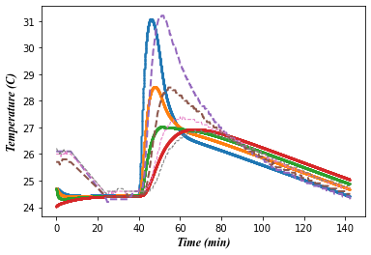
Boundary conditions, 2D Model.
Monitoring Points
31.0 (45.99 min) C – 31.2 C (48.7min)
28.52 (48.0 min) C – 28.5 C (54.3min)
27.00 (49.94 min) C – 27.4 C (60.0 min)
26.93 (65.15 min) C – 26.9 C (67.3 min)

Slide 15
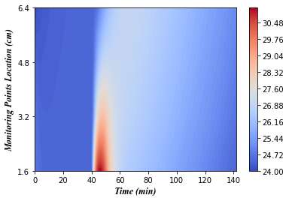
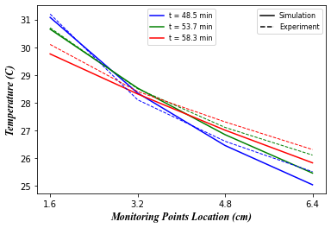
Boundary conditions, 2D Model.
Monitoring Points

Slide 16
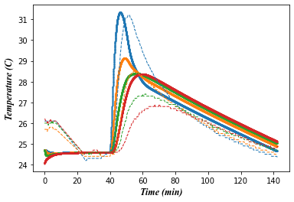
Injection Point attribute | Rock attribute | Boundary Attribute
Heat rate = 1000 watts | - | ca_t = 24.7 C | ca_t = 24.7 C
ca_mc =300 | ca_mc =vol*2600*1000n -1.3 | Ca_mc = 1.0 | Ca_mc = 1.0
fa_heatg = 2.0 | fa_heatg = 2.0 | fa_heat = 5.0 | fa_heat = 5.0

Slide 17
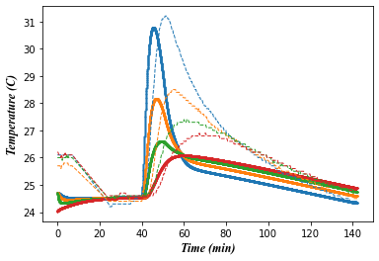
Injection Point attribute | Rock attribute | Boundary Attribute
Heat rate = 1000 watts | - | ca_t = 24.7 C | ca_t = 24.7 C
ca_mc =300 | ca_mc =vol*2600*1000n -1.3 | Ca_mc = 3.0 | Ca_mc = 3.0
fa_heatg = 2.0 | fa_heatg = 2.0 | fa_heat = 5.0 | fa_heat = 5.0

Slide 18
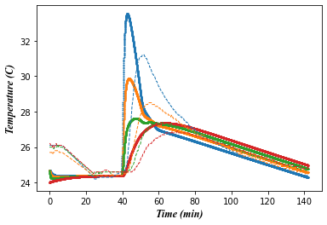
Injection Point attribute | Rock attribute | Boundary Attribute
Heat rate = 1000 watts | - | ca_t = 24.7 C | ca_t = 24.7 C
ca_mc =300 | ca_mc =vol*2600*1000 -1.5 | Ca_mc = 1.0 | Ca_mc = 3.0
fa_heatg = 2.0 | fa_heatg = 2.0 | fa_heat = 5.0 | fa_heat = 5.0

Slide 19
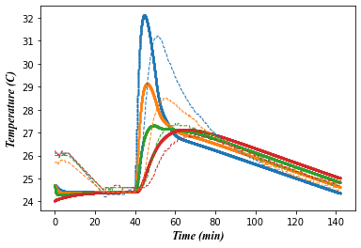
Injection Point attribute | Rock attribute | Boundary Attribute
Heat rate = 1000 watts | - | ca_t = 24.7 C | ca_t = 24.7 C
ca_mc =300 | ca_mc =vol*2600*1000 -1.4 | Ca_mc = 1.0 | Ca_mc = 3.0
fa_heatg = 2.0 | fa_heatg = 2.0 | fa_heat = 5.0 | fa_heat = 5.0

Slide 20
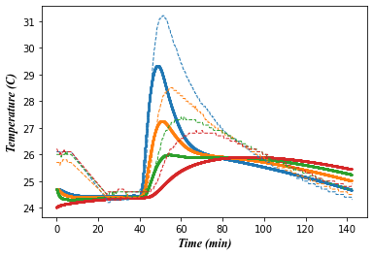
Injection Point attribute | Rock attribute | Boundary Attribute
Heat rate = 1000 watts | - | ca_t = 24.7 C | ca_t = 24.7 C
ca_mc =300 | ca_mc =vol*2600*1000 -1.3 | Ca_mc = 1.0 | Ca_mc = 3.0
fa_heatg = 2.0 | fa_heatg = 1.0 | fa_heat = 5.0 | fa_heat = 5.0

Slide 21
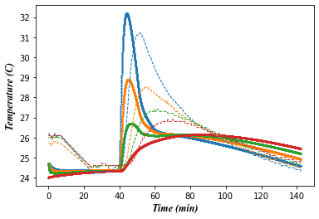
Injection Point attribute | Rock attribute | Boundary Attribute
Heat rate = 1000 watts | - | ca_t = 24.7 C | ca_t = 24.7 C
ca_mc =300 | ca_mc =vol*2600*1000 -1.5 | Ca_mc = 1.0 | Ca_mc = 3.0
fa_heatg = 2.0 | fa_heatg = 1.0 | fa_heat = 5.0 | fa_heat = 5.0

Slide 22
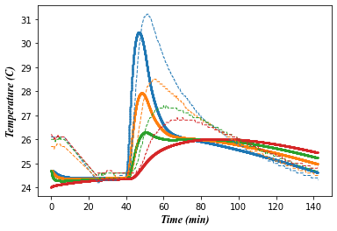
Injection Point attribute | Rock attribute | Boundary Attribute
Heat rate = 1000 watts | - | ca_t = 24.7 C | ca_t = 24.7 C
ca_mc =300 | ca_mc =vol*2600*1000 -1.4 | Ca_mc = 1.0 | Ca_mc = 3.0
fa_heatg = 2.0 | fa_heatg = 1.0 | fa_heat = 5.0 | fa_heat = 5.0

Slide 23
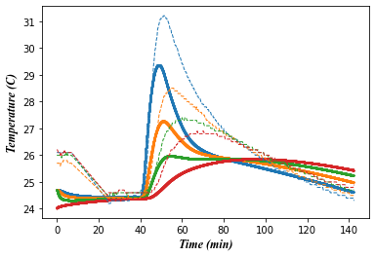
Injection Point attribute | Rock attribute | Boundary Attribute
Heat rate = 1000 watts | - | ca_t = 24.7 C | ca_t = 24.7 C
ca_mc =300 | ca_mc =vol*2600*1000 -1.3 | Ca_mc = 1.0 | Ca_mc = 3.0
fa_heatg = 2.0 | fa_heatg = 1.0 | fa_heat = 1.0 | fa_heat = 1.0

Slide 24
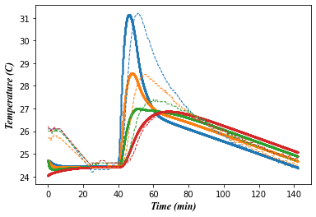
Injection Point attribute | Rock attribute | Boundary Attribute
Heat rate = 1000 watts | - | ca_t = 24.7 C | ca_t = 24.7 C
ca_mc =300 | ca_mc =vol*2600*1000 -1.3 | Ca_mc = 1.0 | Ca_mc = 3.0
fa_heatg = 2.0 | fa_heatg = 2.0 | fa_heat = 2.0 | fa_heat = 2.0

Slide 25

Injection Point attribute | Rock attribute | Boundary Attribute
Heat rate = 1000 watts | - | ca_t = 24.7 C | ca_t = 24.7 C
ca_mc =300 | ca_mc =vol*2600*1000n -1.3 | Ca_mc = 1.0 | Ca_mc = 3.0
fa_heatg = 2.0 | fa_heatg = 2.0 | fa_heat = 5.0 | fa_heat = 5.0

Slide 26
Injection Point attribute | Rock attribute | Boundary Attribute
Heat rate = 1000 watts | - | ca_t = 24.7 C | ca_t = 24.7 C
ca_mc =300 | ca_mc =vol*2600*1000 -1.3 | Ca_mc = 1.0 | Ca_mc = 3.0
fa_heatg = 2.0 | fa_heatg = 2.0 | fa_heat = 3.0 | fa_heat = 3.0

Slide 27
1. Input reservoir parameters used in the simulation
Fluid
Temperature | Fa_t | K | 338
Heat Specific | Fa_c | J/(kG*K) | Gas | 1000
 |  |  | Water | 4000
 |  |  | Oil | 1800
 |  |  | kero | 2000
Rock/Cell
Rock heat capacity | ca_mc
Rock temperature | ca_t
Heat transfer coefficient | ca_g
Heat conductivity | fa_heatg
Rock density |  | Kg/m3 | 2600
Wang Zijie et al 2020 and Xue liang et al 2019
Kerogen
Temperature decomp. | ka_teq
Activation energy | ka_dE
Half time life reaction | ca_k2o
Density
Lee at al 2017
Dang et al, 2016 A new approach to measure organic density Kerogen density appears to be kerogen-type dependent Type III density ranges from 1.6 to 1.8 g/cm3. Plot Fig.11 show average of 1.5g/cc = 1500kg/m3

Slide 28
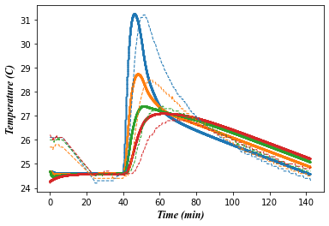
Virtual cell
Injection Point attribute | Rock attribute | Boundary Attribute
Heat rate = 1000 watts | - | ca_t = 24.7 C | ca_t = 24.7 C
ca_mc =300 | ca_mc =vol*2600*1000 -1.3 | Ca_mc = 1.0 | Ca_mc = 1.0
fa_heatg = 2.0 | fa_heatg = 2.0 | fa_heat = 3.0 | fa_heat = 3.0

Slide 29
Virtual cell
Injection Point attribute | Rock attribute | Boundary Attribute
Heat rate = 1000 watts | - | ca_t = 24.7 C | ca_t = 24.7 C
ca_mc =300 | ca_mc =vol*2600*1000 -1.3 | Ca_mc = 1.0 | Ca_mc = 1.0
fa_heatg = 2.0 | fa_heatg = 2.0 | fa_heat = 3.0 | fa_heat = 3.0
No effect

